Slide 1
Flow of Control
As in most programming languages, flow of control in Java refers to its branching and looping mechanisms
Java has several branching mechanisms: if-else, if, and switch statements
Java has three types of loop statements: the while, do-while, and for statements
Most branching and looping statements are controlled by Boolean expressions
A Boolean expression evaluates to either true or false
The primitive type boolean may only take the values true or false

Slide 2
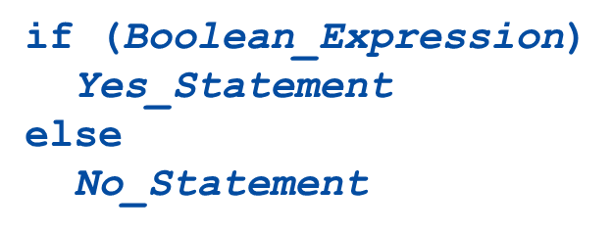
Branching with an if-else Statement (2 of 2)
An if-else statement chooses between two alternative statements based on the value of a Boolean expression
The Boolean_Expression must be enclosed in parentheses
If the Boolean_Expression is true, then the Yes_Statement is executed
If the Boolean_Expression is false, then the No_Statement is executed

Slide 3
Compound Statements (1 of 2)
Each Yes_Statement and No_Statement branch of an if-else can be a made up of a single statement or many statements
Compound Statement: A branch statement that is made up of a list of statements
A compound statement must always be enclosed in a pair of braces
A compound statement can be used anywhere that a single statement can be used

Slide 4
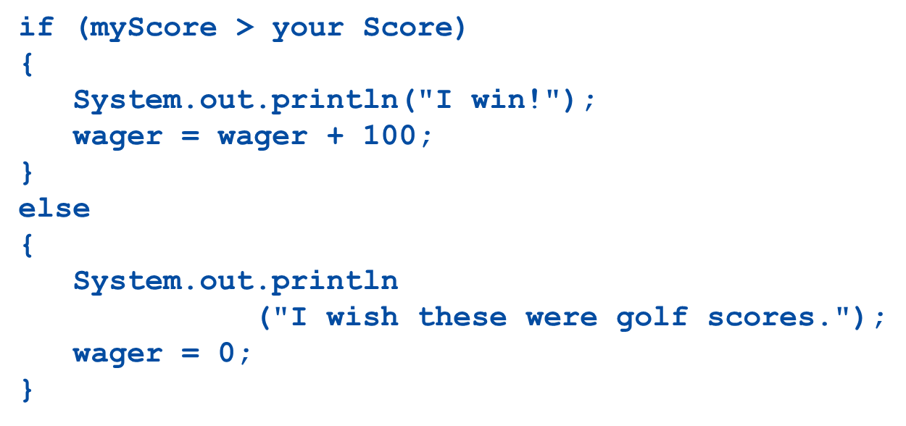
Compound Statements (2 of 2)

Slide 5
Nested Statements
if-else statements and if statements both contain smaller statements within them
For example, single or compound statements
In fact, any statement at all can be used as a subpart of an if-else or if statement, including another if-else or if statement
Each level of a nested if-else or if should be indented further than the previous level
Exception: multiway if-else statements

Slide 6
Multiway if-else Statements (1 of 2)
The multiway if-else statement is simply a normal if-else statement that nests another if-else statement at every else branch
It is indented differently from other nested statements
All of the Boolean_Expressions are aligned with one another, and their corresponding actions are also aligned with one another
The Boolean_Expressions are evaluated in order until one that evaluates to true is found
The final else is optional

Slide 7
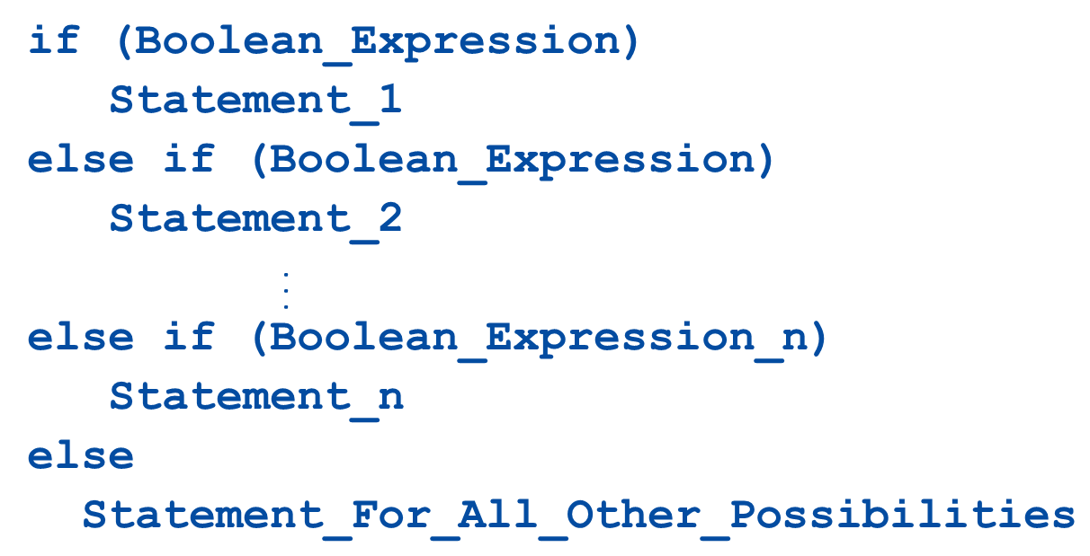
Multiway if-else Statement (2 of 2)

Slide 8
The Switch Statement (1 of 5)
The switch statement is the only other kind of Java statement that implements multiway branching
When a switch statement is evaluated, one of a number of different branches is executed
The choice of which branch to execute is determined by a controlling expression enclosed in parentheses after the keyword switch
The controlling expression must evaluate to a char,int,short,or byte

Slide 9
The Switch Statement (2 of 5)
Each branch statement in a switch statement starts with the reserved word case, followed by a constant called a case label, followed by a colon, and then a sequence of statements
Each case label must be of the same type as the controlling expression
Case labels need not be listed in order or span a complete interval, but each one may appear only once
Each sequence of statements may be followed by a break statement ( break;)

Slide 10
The Switch Statement (3 of 5)
There can also be a section labeled default:
The default section is optional, and is usually last
Even if the case labels cover all possible outcomes in a given switch statement, it is still a good practice to include a default section
It can be used to output an error message, for example
When the controlling expression is evaluated, the code for the case label whose value matches the controlling expression is executed
If no case label matches, then the only statements executed are those following the default label (if there is one)

Slide 11
The Switch Statement (4 of 5)
The switch statement ends when it executes a break statement, or when the end of the switch statement is reached
When the computer executes the statements after a case label, it continues until a break statement is reached
If the break statement is omitted, then after executing the code for one case, the computer will go on to execute the code for the next case
If the break statement is omitted inadvertently, the compiler will not issue an error message

Slide 12
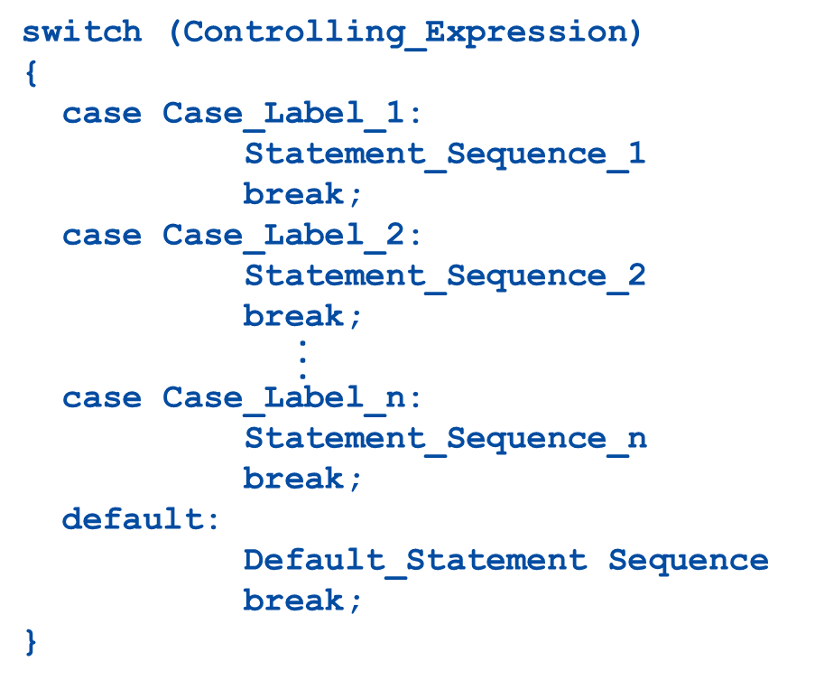
The switch Statement (5 of 5)

Slide 13
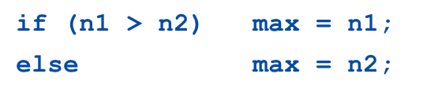

The Conditional Operator (1 of 2)
The conditional operator is a notational variant on certain forms of the if-else statement
Also called the ternary operator or arithmetic if
The following examples are equivalent:
versus

Slide 14
The Conditional Operator (2 of 2)
The expression to the right of the assignment operator is a conditional operator expression
If the Boolean expression is true, then the expression evaluates to the value of the first expression (n1), otherwise it evaluates to the value of the second expression (n2)

Slide 15
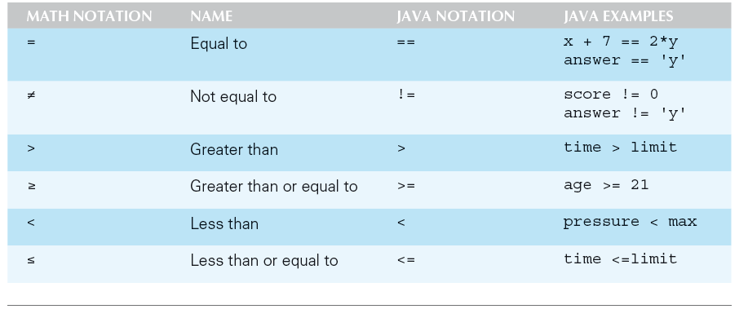
Simple Boolean Expressions
Display 3.3 Java Comparison Operators

Slide 16
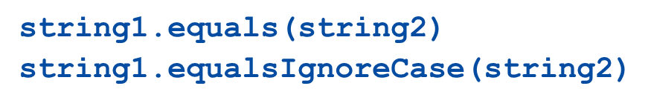
Pitfall: Using == with Strings
The equality comparison operator (==) can correctly test two values of a primitive type
However, when applied to two objects such as objects of the String class, == tests to see if they are stored in the same memory location, not whether or not they have the same value
In order to test two strings to see if they have equal values, use the method equals, or equalsIgnoreCase

Slide 17
Building Boolean Expressions (1 of 2)
When two Boolean expressions are combined using the "and" (&&) operator, the entire expression is true provided both expressions are true
Otherwise the expression is false
When two Boolean expressions are combined using the "or" (||) operator, the entire expression is true as long as one of the expressions is true
The expression is false only if both expressions are false

Slide 18
Building Boolean Expressions (2 of 2)
Any Boolean expression can be negated using the ! Operator
Place the expression in parentheses and place the ! operator in front of it
Unlike mathematical notation, strings of inequalities must be joined by &&
Use
rather than

Slide 19
Evaluating Boolean Expressions
Even though Boolean expressions are used to control branch and loop statements, Boolean expressions can exist independently as well
A Boolean variable can be given the value of a Boolean expression by using an assignment statement
A Boolean expression can be evaluated in the same way that an arithmetic expression is evaluated
The only difference is that arithmetic expressions produce a number as a result, while Boolean expressions produce either true or false as their result

Slide 20
Loops
Loops in Java are similar to those in other high-level languages
Java has three types of loop statements: the while, the do-while, and the for statements
The code that is repeated in a loop is called the body of the loop
Each repetition of the loop body is called an iteration of the loop

Slide 21
While Statement
A while statement is used to repeat a portion of code (i.e., the loop body) based on the evaluation of a Boolean expression
The Boolean expression is checked before the loop body is executed
When false, the loop body is not executed at all
Before the execution of each following iteration of the loop body, the Boolean expression is checked again
If true, the loop body is executed again
If false, the loop statement ends
The loop body can consist of a single statement, or multiple statements enclosed in a pair of braces

Slide 22
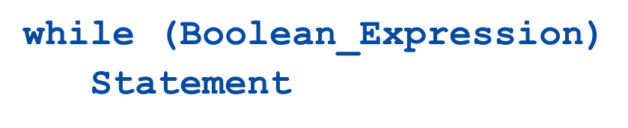
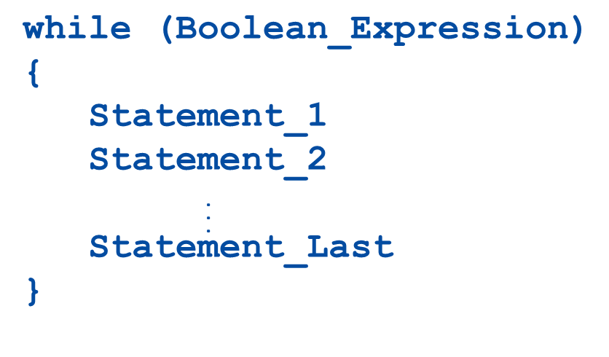
While Syntax
or

Slide 23
Do-While Statement (1 of 2)
A do-while statement is used to execute a portion of code (i.e., the loop body), and then repeat it based on the evaluation of a Boolean expression
The loop body is executed at least once
The Boolean expression is checked after the loop body is executed

Slide 24
Do-While Statement (2 of 2)
The Boolean expression is checked after each iteration of the loop body
If true, the loop body is executed again
If false, the loop statement ends
Don't forget to put a semicolon after the Boolean expression
Like the while statement, the loop body can consist of a single statement, or multiple statements enclosed in a pair of braces ({ })

Slide 25
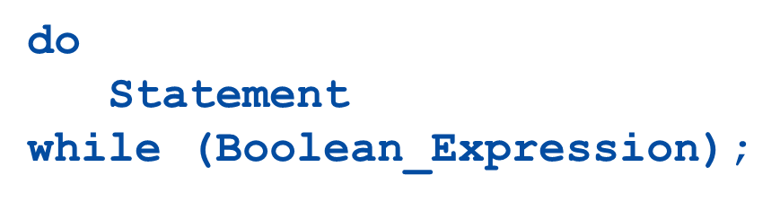
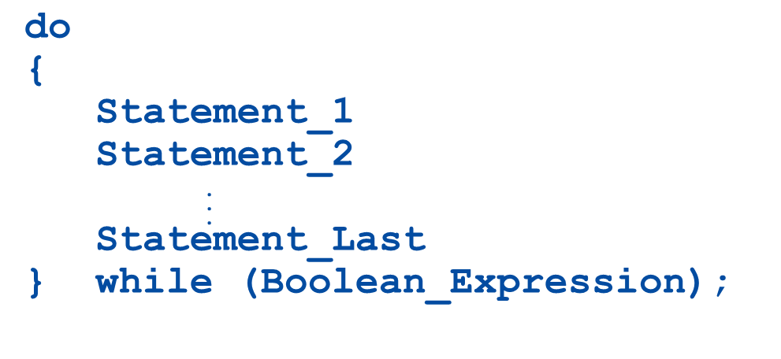
Do-While Syntax
or

Slide 26
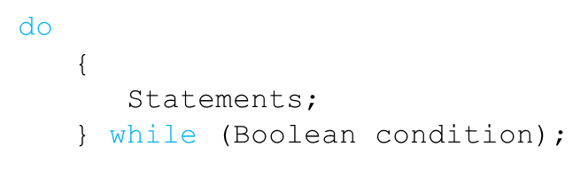
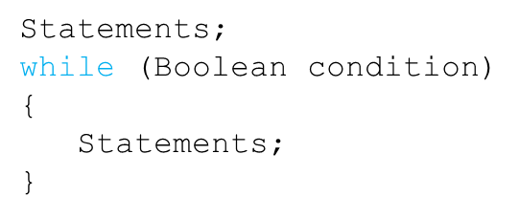
Equivalence of while and do-while loop (1 of 2)
Given the following structure for a do-while loop:
The equivalent while loop is:

Slide 27
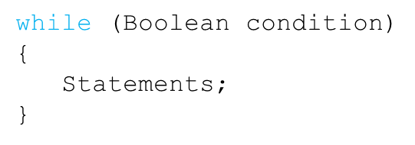
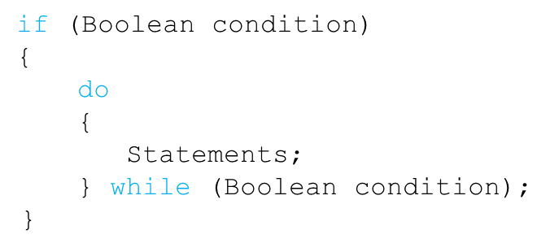
Equivalence of while and do-while loop (2 of 2)
Given the following structure for a while loop:
The equivalent do-while loop is:

Slide 28
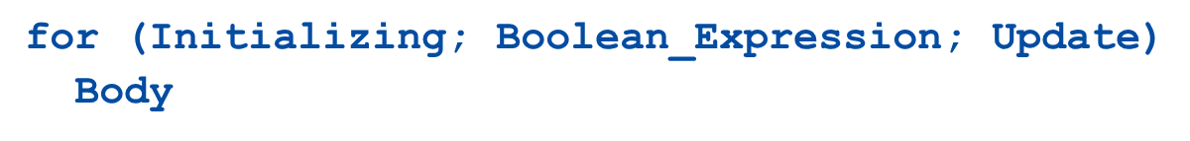
The for Statement Syntax
The Body may consist of a single statement or a list of statements enclosed in a pair of braces
Note that the three control expressions are separated by two, not three, semicolons
Note that there is no semicolon after the closing parenthesis at the beginning of the loop

Slide 29
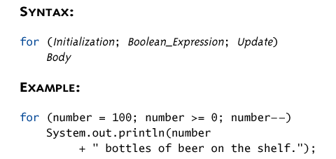
The for Statement (4 of 5)
Display 3.10 for Statement syntax and alternative Semantics (Part 1 of 2)
The For Statement Syntax:

Slide 30
Infinite Loops
A while, do-while, or for loop should be designed so that the value tested in the Boolean expression is changed in a way that eventually makes it false, and terminates the loop
If the Boolean expression remains true, then the loop will run forever, resulting in an infinite loop
Loops that check for equality or inequality (== or !=) are especially prone to this error and should be avoided if possible

Slide 31
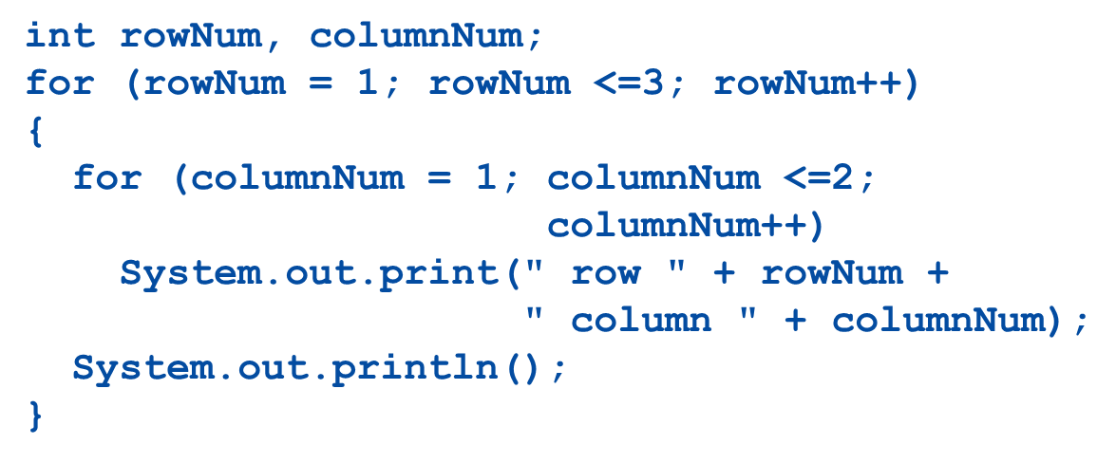
Nested Loops
Loops can be nested, just like other Java structures
When nested, the inner loop iterates from beginning to end for each single iteration of the outer loop

Slide 32
The break and continue Statements (1 of 2)
The break statement consists of the keyword break followed by a semicolon
When executed, the break statement ends the nearest enclosing switch or loop statement
The continue statement consists of the keyword continue followed by a semicolon
When executed, the continue statement ends the current loop body iteration of the nearest enclosing loop statement

Slide 33
The break and continue Statements (2 of 2)
Note that in a for loop, the continue statement transfers control to the update expression
When loop statements are nested, remember that any break or continue statement applies to the innermost, containing loop statement

Slide 34
The exit Statement
A break statement will end a loop or switch statement, but will not end the program
The exit statement will immediately end the program as soon as it is invoked:
The exit statement takes one integer argument
By tradition, a zero argument is used to indicate a normal ending of the program

Slide 35

Assertion Checks (1 of 2)
An assertion is a sentence that says (asserts) something about the state of a program
An assertion must be either true or false, and should be true if a program is working properly
Assertions can be placed in a program as comments
Java has a statement that can check if an assertion is true
If assertion checking is turned on and the Boolean_Expression evaluates to false, the program ends, and outputs an assertion failed error message
Otherwise, the program finishes execution normally

Slide 36
Assertion Checks (2 of 2)
A program or other class containing assertions is compiled in the usual way
After compilation, a program can run with assertion checking turned on or turned off
Normally a program runs with assertion checking turned off
In order to run a program with assertion checking turned on, use the following command (using the actual Program Name):

Slide 37

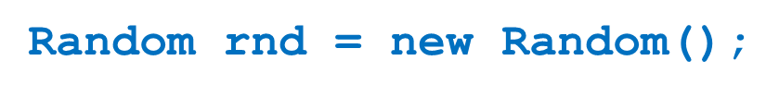
Generating Random Numbers (1 of 2)
The Random class can be used to generate pseudo-random numbers
Not truly random, but uniform distribution based on a mathematical function and good enough in most cases
Add the following import
Create an object of type Random

Slide 38
Generating Random Numbers
To generate random numbers use the
method to get a random number from 0 to n-1
// Random number from 0 to 9
Use the
method to get a random number from 0 to 1 (always less than 1)

Slide 39
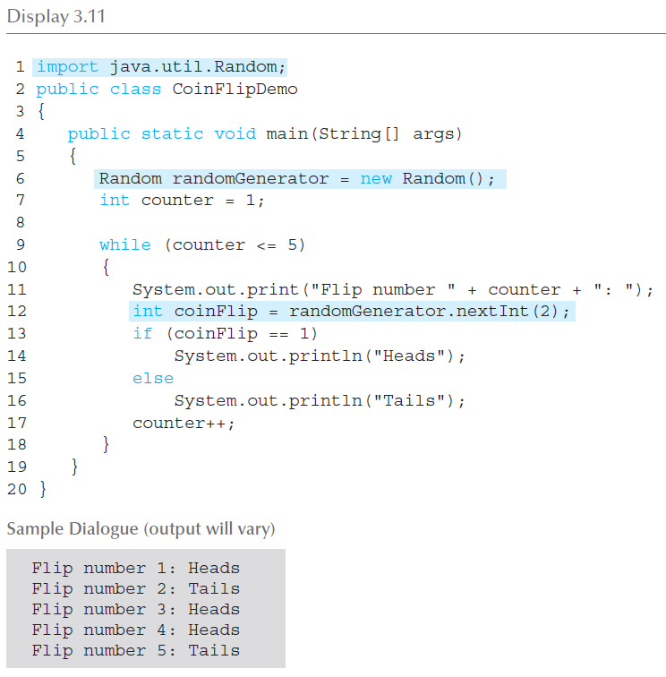
Simulating a Coin Flip
Display 3.11

